Slide 1
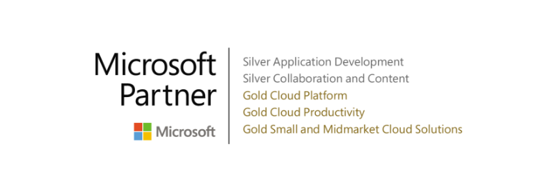
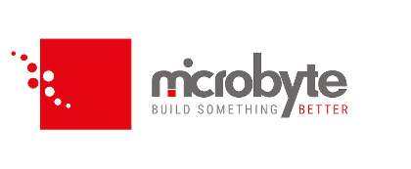
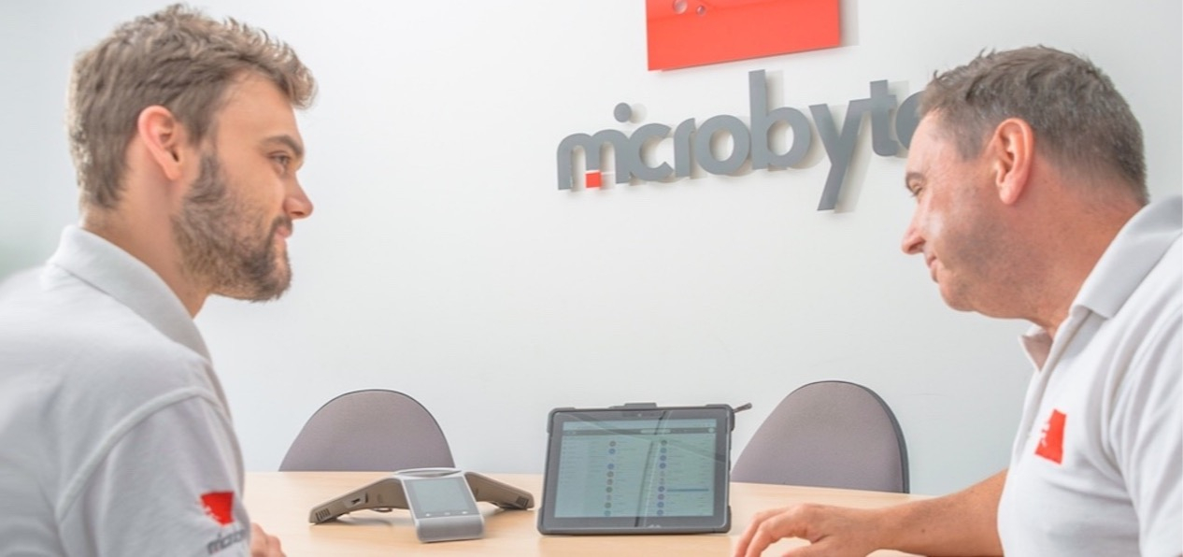

Microbyte supports Belvoir growth with Microsoft Azure hybrid cloud solution
Belvoir, the largest residential property franchise group in the United Kingdom, needed a new IT infrastructure to support its growing network of customers, franchisees, and staff. The company had just one internal server handling all of its business processes and enterprise resource planning (ERP), and it urgently needed to provide better onboarding and remote access for 300-plus locations. Additionally, Belvoir needed to meet strict security regulations and compliance standards. Microbyte recommended a hybrid cloud solution hosted on Microsoft Azure to speed up onboarding, connect employees, and ensure compliance.
AT A GLANCE
Customer: Belvoir
Website: https://www.belvoir.co.uk
Customer Size: Medium (50 - 999 employees)
Country: UK
Industry: Other
Products and Services: Microsoft Azure

Slide 2

Microbyte,
Belvoir, & Microsoft Azure
Customer Challenges
Belvoir was running its operations on one internal server for all of its business processes and ERP, making staff onboarding a time-intensive task. Further, disaster recovery quotes for its current system were cost-prohibitive, and the company faced issues with hosted desktops, including data volume limits and maintenance cost. Belvoir tasked Microbyte with finding a hybrid cloud solution that would work with its existing ERP while giving staff members remote access and complete data security.
Partner Solution
Microbyte mapped out a staged approach for moving Belvoir's local servers and systems to the cloud. It repurposed the realty company's internal server to house onsite media content and act as a backup domain controller. Microbyte also set up Microsoft Remote Desktop Services (RDS) to migrate Belvoir’s data off-site and enable employees to access systems from anywhere within a secure environment. Because it wasn't possible to increase the accessibility of its ERP via VPN, Microbyte spun up a server to house the SQL databases and ERP.
Customer Benefits
With the Microbyte solution built on Azure in place, Belvoir can now onboard staff and clients easily. Its IT operations are fully compliant, and it has faster remote access to its data, so it can continue to expand rapidly. Belvoir also reports faster onboarding times and improved productivity and uptime for remote users. Microbyte fully manages the hybrid cloud solution on Azure, along with Belvoir’s internal servers, phone systems, and network.
"We now have the infrastructure in place to effectively onboard data from any property companies we acquire," — Tom Crowther, Head of IT at Belvoir
"Microbyte have been much more than a service provider, they’re our business partner, an extension of ourselves whom we work incredibly closely with."
"The infrastructure we now have in place also means that when we upgrade our ERP, we only have to do it once on the RDS server, rather than having to update individual desktops."

